Slide 1
Customer Orders Database – Final Project Overview
Group Members:
Sameer Basha Mohammad Hothur
Brendan Gillow
Chandra Kiran Challamalasetti
Tools Used:
Microsoft SQL Server, Jupyter Notebook (Python), MS Word, Zoom
Goals:
Normalize data
Create efficient SQL/Python workflow
Visualize sales trends
Notes:
Hello everyone, welcome to our group presentation for the Customer Orders Database project. Our team includes Sameer Basha Mohammad Hothur, Brendan Gillow, and Chandra Kiran Challamalasetti. This project focuses on designing a normalized database in 3NF for tracking customer orders, their salespersons, and order details. We used SQL Server for database development, Jupyter notebooks for Python integration, and various diagrams to visualize insights from the data.

Slide 2
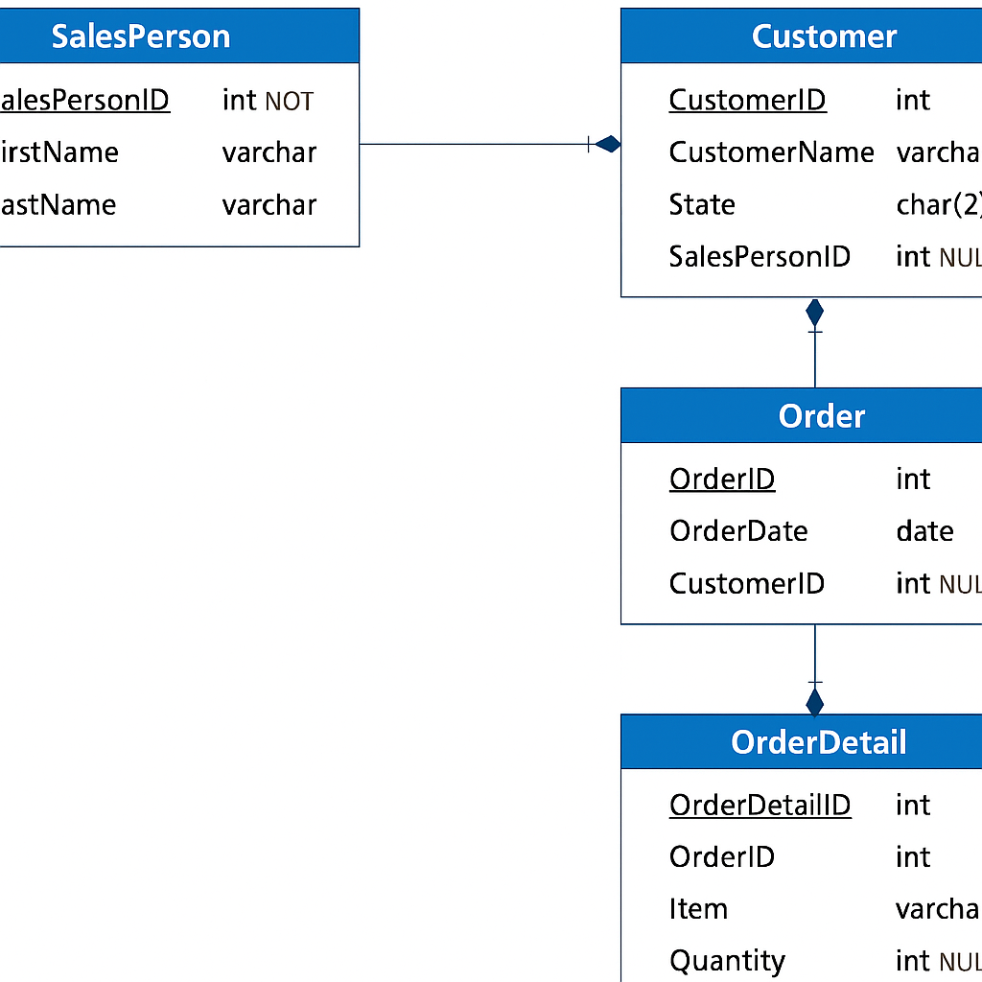
Table Design & Entity-Relationship Diagram
3NF normalization applied
5 Main Tables:
Sales Person
Customer
Order
Order DetailI
Item
Notes:
We designed the database in third normal form to ensure minimal redundancy and strong data integrity. Here's our Entity-Relationship Diagram showing the logical structure. The primary and foreign keys are clearly marked to define relationships like which salesperson is assigned to which customer, and which order belongs to which customer. This design supports scalability and clean data querying.

Slide 3
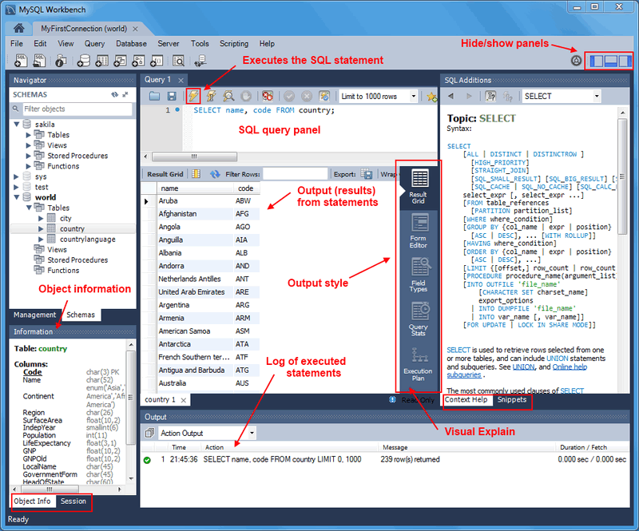
SQL Statements – Structure & Data Insertion
All tables created using SQL DDL
25+ records inserted into each table using DML
Stored procedure: Add Sales Person
Function: Convert USD To EUR
This Photo by Unknown Author is licensed under CC BY-SA
Notes:
This slide showcases our SQL work. We created the database schema using DDL statements, then inserted over 25 rows into each table using DML. We implemented a stored procedure to add a new salesperson securely, and a user-defined function to convert item prices from USD to Euro based on exchange rates. All SQL code has been tested in MS SQL Server and included in a .sql file submission.

Slide 4
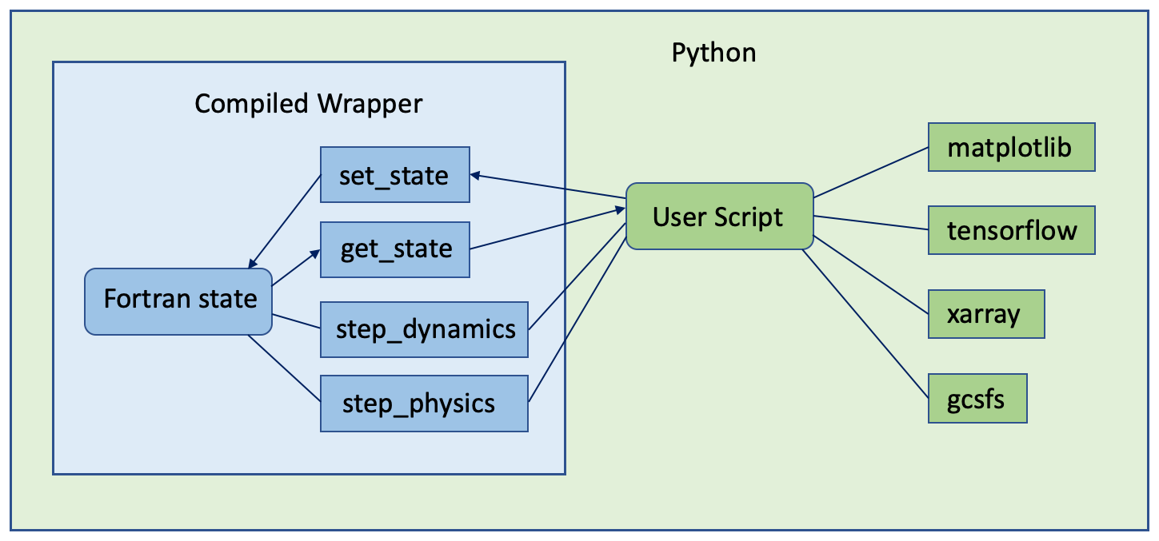
Python Integration for Data Insertion
Used pyodbc and pandas
Automated bulk inserts
Data cleaning and transformation handled in Python
Code runs in Jupyter Notebook
This Photo by Unknown Author is licensed under CC BY
Notes:
For data automation, we used Python with Jupyter Notebook. Libraries like pyodbc and pandas allowed us to connect to SQL Server and insert data efficiently. This method ensures repeatable and testable workflows, which is especially helpful for larger datasets and future scaling. We've included the full Jupyter notebook as part of our submission.

Slide 5
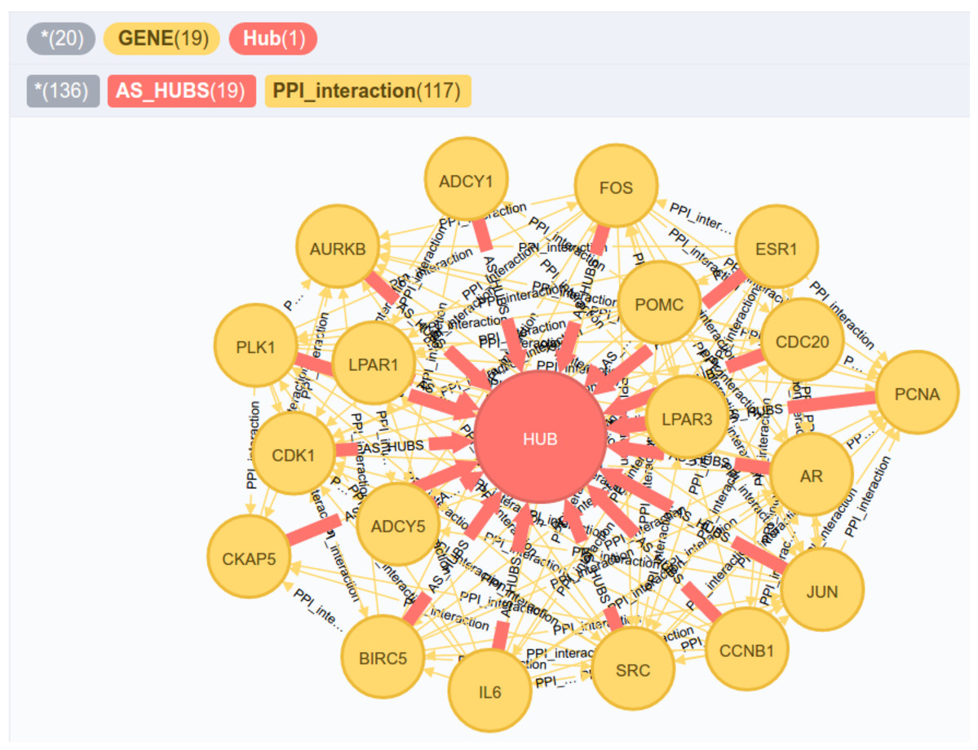
Database Views for Analysis
Views created:
Customers and Sales person
Most expensive item per customer
Most expensive item sold per salesperson
Total item purchase by customer
Enables reporting and trend analysis
This Photo by Unknown Author is licensed under CC BY
Notes:
We created SQL views to extract meaningful business insights. These views join multiple tables and use aggregate functions to determine high-value customers and sales performance. For example, we identify the most expensive item purchased by each customer and total sales per customer—crucial data for any business analysis.

Slide 6
Sales Visualizations in Python
Used matplotlib and seaborn
Charts created:
Sales by Customer
Sales by State
Diagrams enhance business understanding
Notes:
In this slide, we present the visual analytics. Using matplotlib and seaborn, we plotted total sales by customer and by state. These charts help businesses spot geographic trends and focus their sales efforts. This integration of SQL data with Python visualizations strengthens data-driven decision-making.

Slide 7
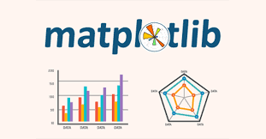
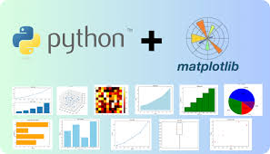

Conclusion & Team Contribution
Summary:
3NF design, SQL, Python integration
Functional views and procedures
Complete project artifacts
Team Roles:
Sameer: SQL + ERD
Brendan: Python + Charts
Chandra: Testing + Stored Procedures

